Slide 1

PROJECT WEBSITE OF A HOTEL

Slide 2
INTRODUCTION
ABOUT THE PROJECT
SUITES AVAILABLE
CONTA
BOOKING OF THE HOTEL
THE FEEDBACK –FORM
OBJECTIVES
Help the user to find the hotel price according to their requirements.
Book the hotel room with the specified dates of the guests need.
Help the guests to select the particular place where they want to book their room.
Also provides them with the types of room available in the hotel with the prices with the minimum days of stay.
Help the hosts to know about the guest from the feedback form.
Provide the guest to about the food requirement

Slide 3
HARDWARE REQUIREMENTS
Laptop with the Intel core i3 processor
SOFTWARE REQUIREMENTS
Window 7 ultimate
Notepad version 6.1(Build 7600)
Google Chrome for the working of JavaScript
Google Chrome for the pictures
LEARNING OUTCOMES
How to use JavaScript
Methods to create a website-
To have a team work-
More knowledge regarding a particular subject-

Slide 4
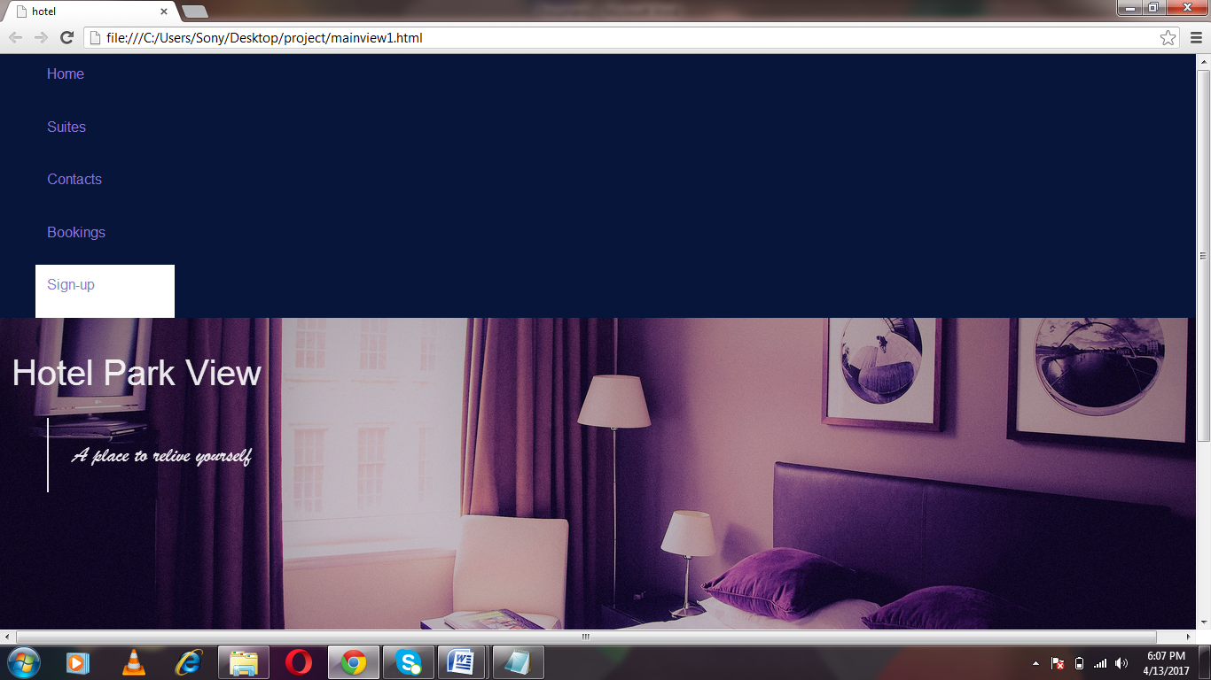
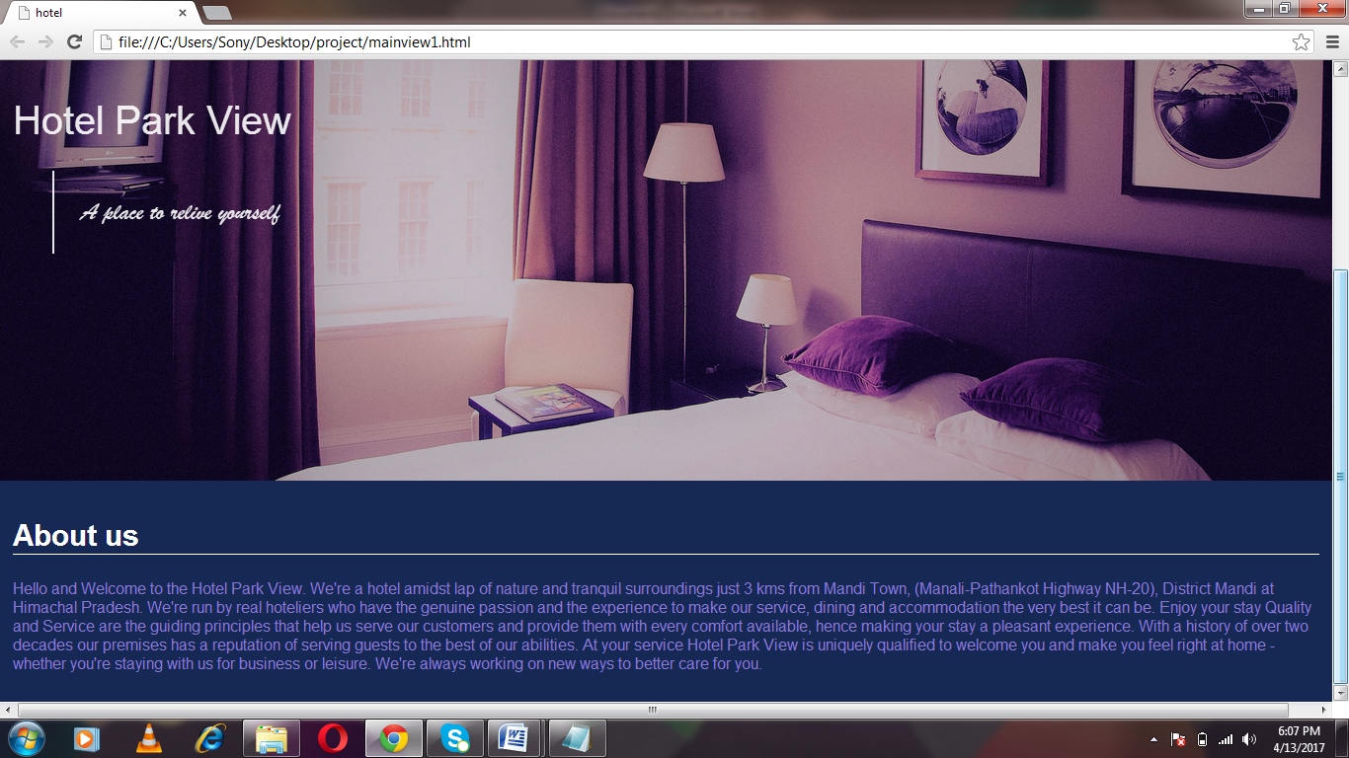
SCREEN LAYOUTS
HOME PAGE

Slide 5
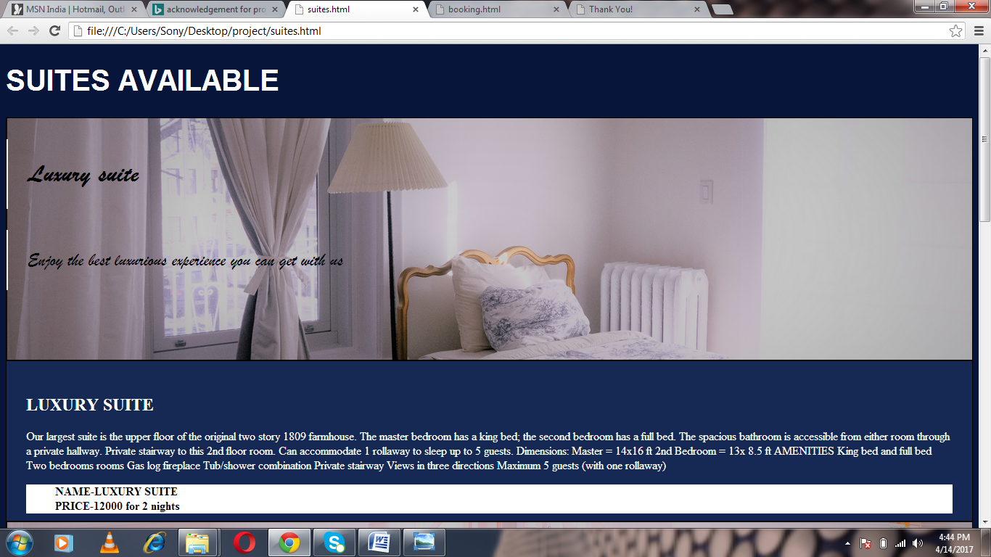
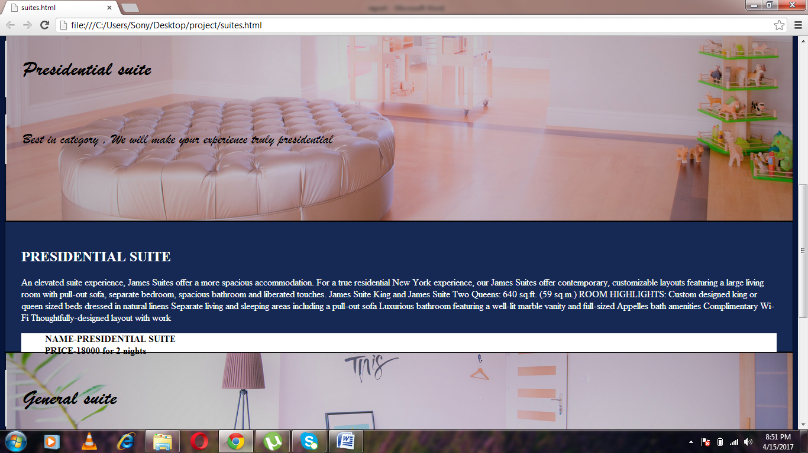
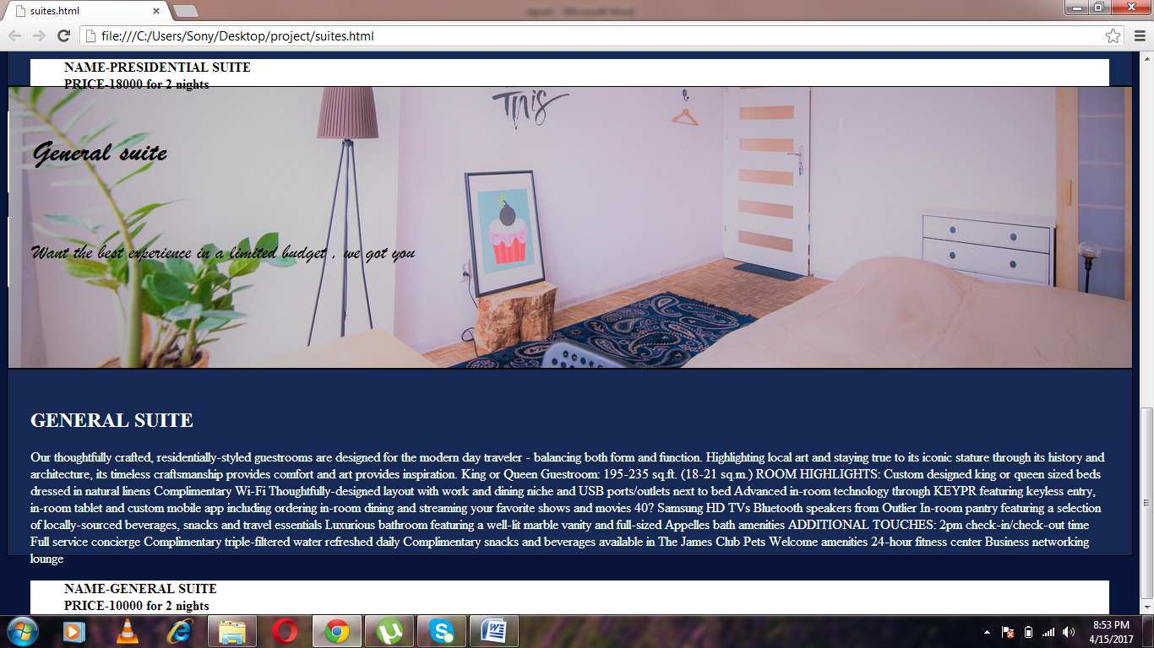
2.SUITES

Slide 6
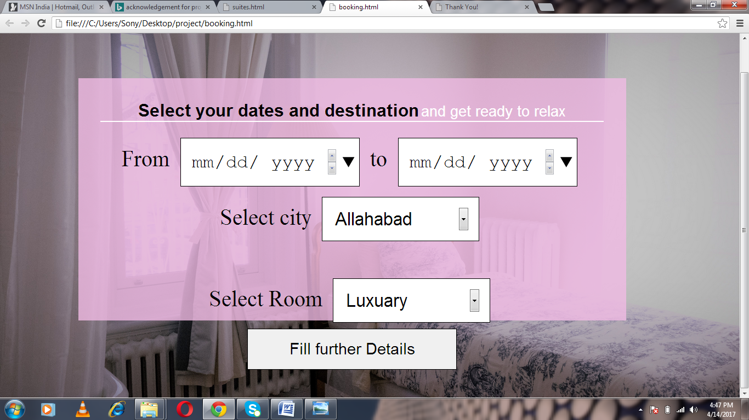
3.BOOKING

Slide 7
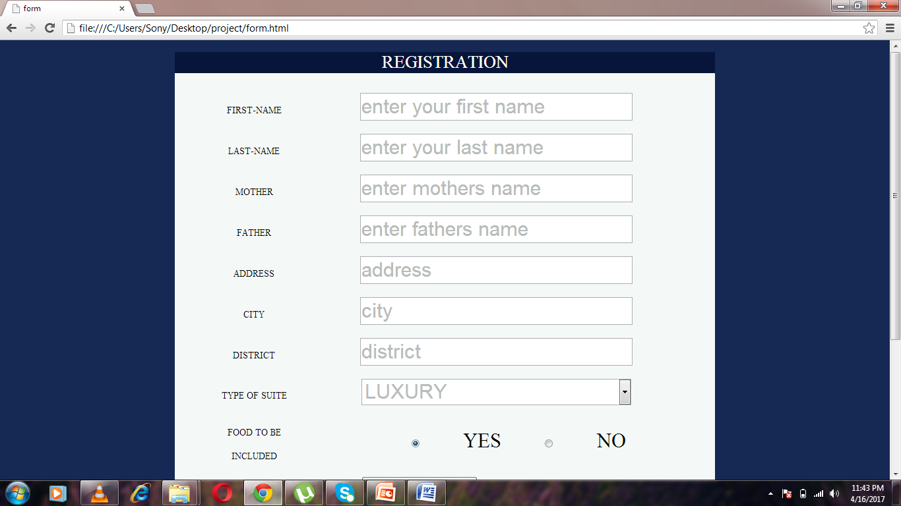
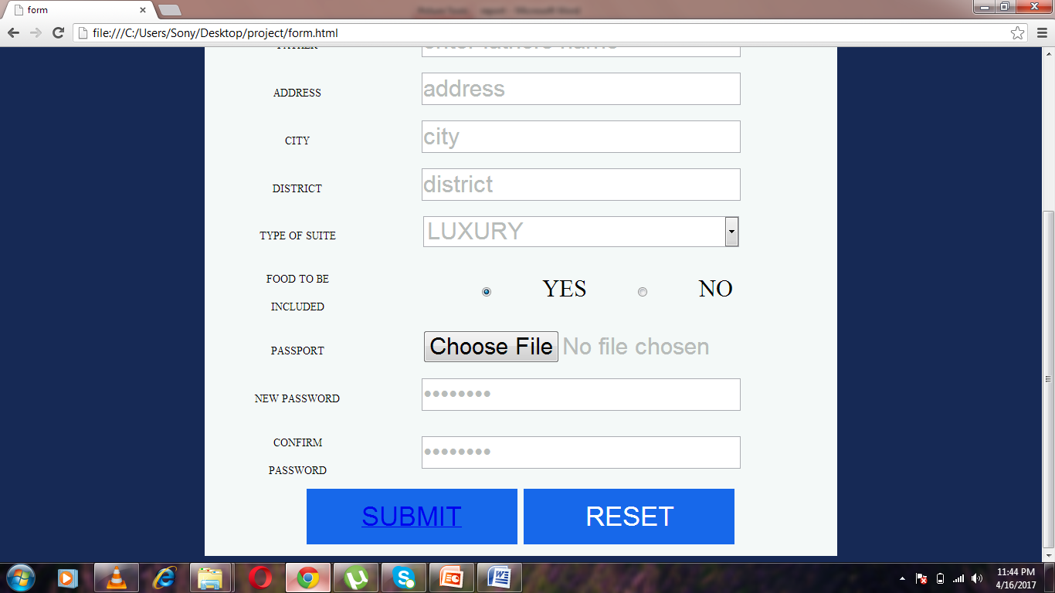
4.SIGN-UP

Slide 8
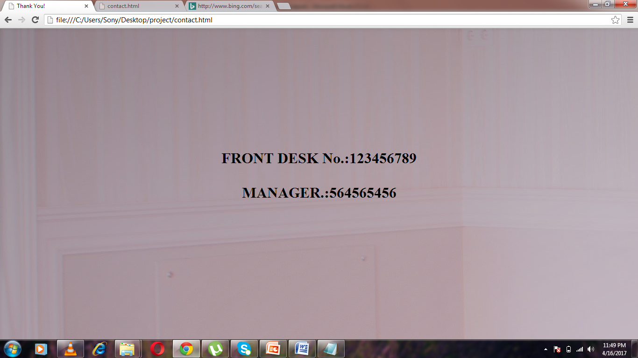
5.CONTACT

Slide 9
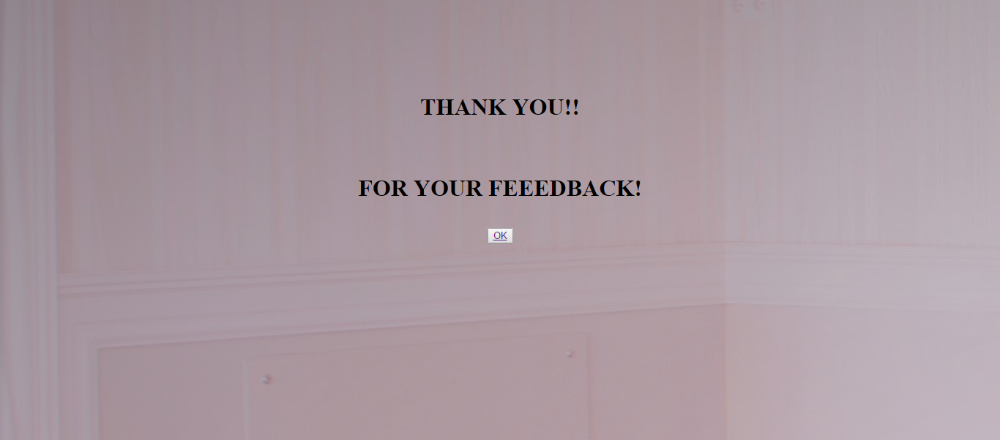
6.FEEDBACK FORM

Slide 10
REFERENCES
Introduction to JavaScript
W3 Schools
YouTube (for the basic tutorials)
LIMITATIONS
Due to the time shortage I am not able to access the database which would help us to know about the particular details filled by our guest.
I will try to overcome this limitation in the future for the proper access of our site.

Slide 11
THANK YOU!

